Slide 1
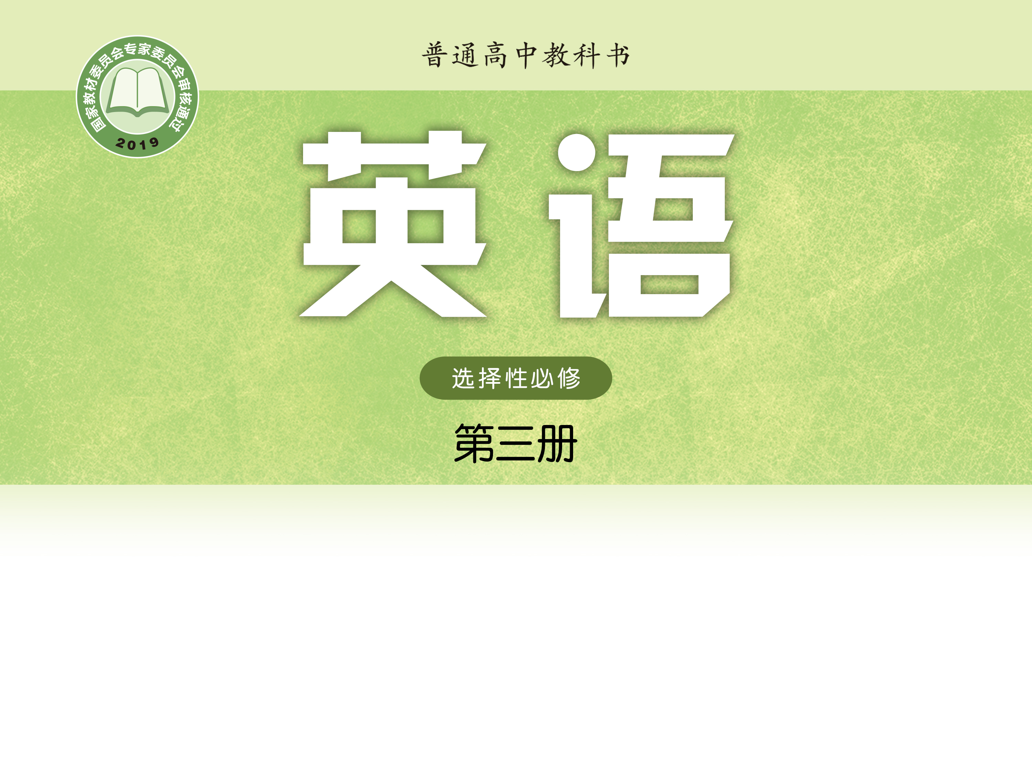
Unit 2 Out of this world
Project
唐德清 巢湖六中

Slide 2
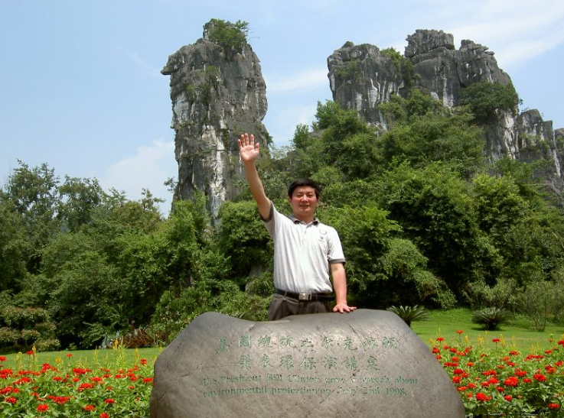
唐德清
巢湖市骨干教师
英语学科带头人、拔尖人才 参与教学参考用书编写
编写初高中教辅100余本

Slide 3
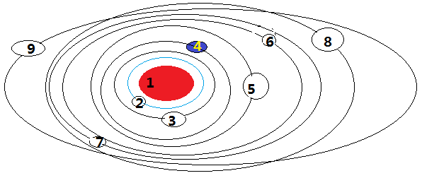
1.The sun
2. Mercury /ˈmɜːkjurɪ/
3. Venus /'viːnəs/
4. Earth
5. Mars
6. Jupiter /ˈdʒuːpɪtə/
7. Saturn /ˈsætən/
8. Uranus / 'jʊərənəs/
9. Neptune /ˈneptjuːn/

Slide 4
Mars is a rather harsh environment
 no oxygen in its atmosphere
 very cold
 radiation
 the atmospheric pressure
in a protected environment in a heated capsule with source of oxygen

Slide 5
Problems | Solutions
Breathable air
Harvest oxygen in the soil
 Collect the buried ice at the south pole of the moon.
Water
 Create water with oxygen and hydrogen shipped from the Earth.
 Manufacture solar cells
Power
 Generate electricity from the reaction of hydrogen and oxygen
 Use nuclear power
Food
Grow food using chemicals like carbon, nitrogen oxygen, hydrogen, etc.

Slide 6
What if we lived on the moon?
Wouldn't it be cool to be able to live, vacation and work on the moon? Let's say we do want to colonize the moon. But there are some basic needs that the moon colonists would have to take care of: breathable air, water, power and food.
Obtaining breathable air, in the form of oxygen, is fairly easy on the moon. The soil on the moon contains oxygen, which can be harvested using heat and electricity.

Slide 7
What if we lived on the moon?
Water is trickier. There’s now some evidence that there may be water, in the form of buried ice that has collected at the south pole of the moon. If so, water mining might be possible.
If water isn't available on the moon, it must be imported from Earth. One way to do that would be to ship liquid hydrogen from the earth to the moon, and then react it with oxygen from the moon's soil to create water. As a side-benefit, the hydrogen can react with oxygen in a fuel cell to create electricity as it creates water.

Slide 8
What if we lived on the moon?
Power on the moon is an interesting challenge. It would probably be possible to manufacture solar cells on the moon, but sunlight is available only part of the time. As mentioned previously, hydrogen and oxygen can react in a fuel cell to create electricity. Nuclear power is another possibility, using uranium mined on the moon.

Slide 9
What if we lived on the moon?
Food is also a problem. The first thought that anyone on Earth would have is, “Grow the food on the moon” using chemicals like carbon, nitrogen oxygen, hydrogen, potassium, phosphorous, and so on. To grow a ton of wheat, you'll have to import all the chemicals not readily available on the moon. Once the first crop is in, and as long as the colony's population is stable, then the chemicals can be reused in a natural cycle. The plant grows, a person eats it, and the person excretes it as solid waste, liquid waste and carbon dioxide in the breath. These waste products then nourish the next batch of plants.

Slide 10
1. dust
Definitions
1. n. fine dry powder consisting of particles of earth, dirt, etc.
2. v. remove dust from (sth.) by wiping
Vocabulary web
dust n.

dusty adj.
duster n.;
dustbin n.

Slide 11
2. shelter
Definitions
1) n. condition of being protected, kept safe, etc.
2) n. structure built to give protection
3) n. building providing refuge, esp. for homeless people
4) v. protect sb./sth., give shelter to sb./sth.
Vocabulary web
shelter v.

sheltered adj.

Slide 12
1. constant
Definitions
1) adj. going on all the time; happening again and again
2) adj. unchanging; fixed
3) adj. firm; faithful
Vocabulary web

constant adj.

constantly adv.
constancy n.

Slide 13
3. constant
Definitions
1) adj. going on all the time; happening again and again
2) adj. unchanging; fixed
3) adj. firm; faithful
Vocabulary web
constancy n.

constant adj.

constantly adv.

Slide 14
4. investment
Definitions
n. the use of money to get a profit or to make a business activity successful, or the money that is used
Vocabulary web

invest v.
investment; n.
invent v.;
invite v.

Slide 15
dust, constant, invent, shelter, invest
1. ________ in hospitals is needed now to match the future needs of the country.
1. Investment
2. The crisis struck the core of the global system, leaving no country ________ from its consequences.
2. sheltered

Slide 16
dust, constant, invent, shelter, invest
3. History is much more than the study of ________ old objects and events long past．
3. dusty
4. She thought ________ about her family; she might never know what had become of them.
4. constantly
5. Before bricks ________, people built their houses of wood.
5. were invented

Slide 17
Homework
1. Watch the micro lesson: Six steps for solving a problem. (Optional)
2. Surf the Internet and find more interesting information about how to live beyond the Earth.

Slide 18
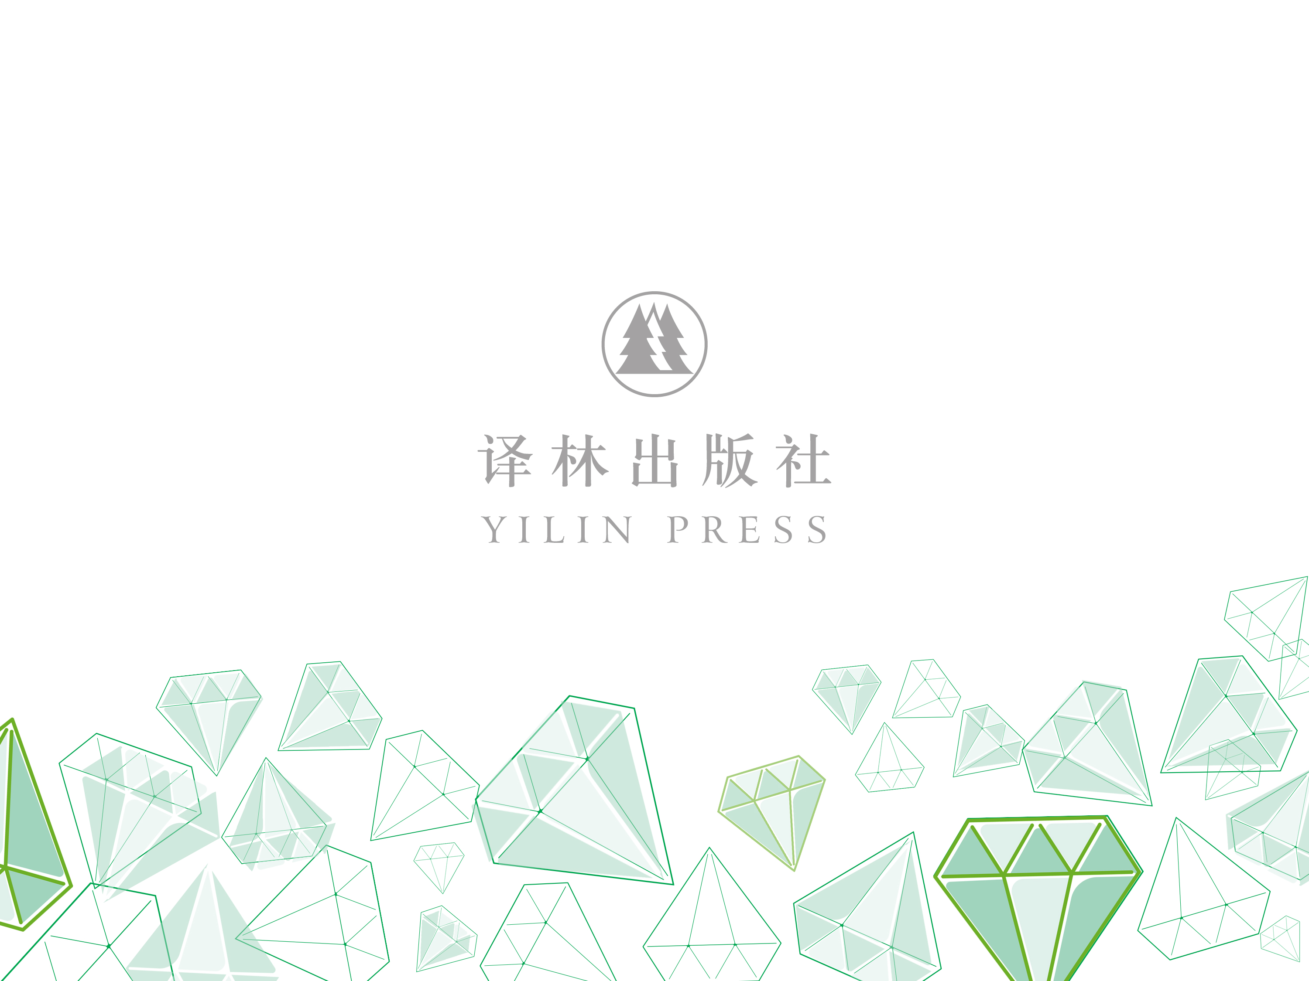
4) These local citizens now have to balance their traditional self-supporting hunting lifestyle with the lifestyle offered by the modern French Republic, which brings with it not only necessary state welfare, but also alcoholism, betrayal and even suicide.
A. The modern French lifestyle.
B. The self-supporting hunting.
C. The uncivilized hunting.
D. The French Republic.


